Slide 1

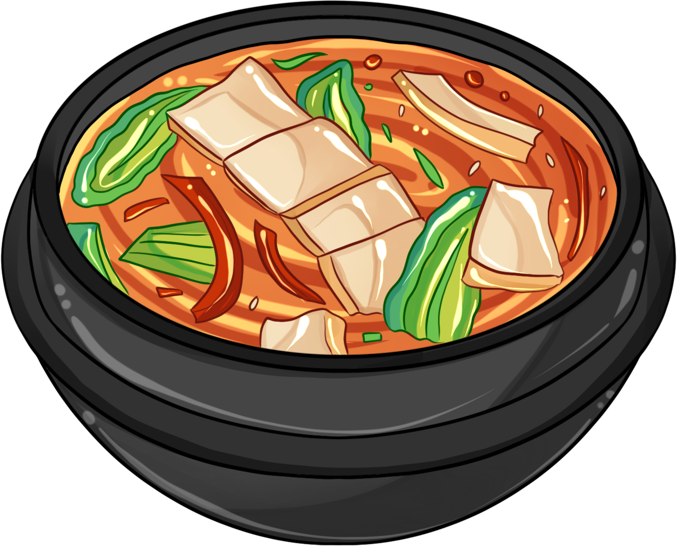

SQL
CASE STUDY
DANNY’S DINER

Slide 2

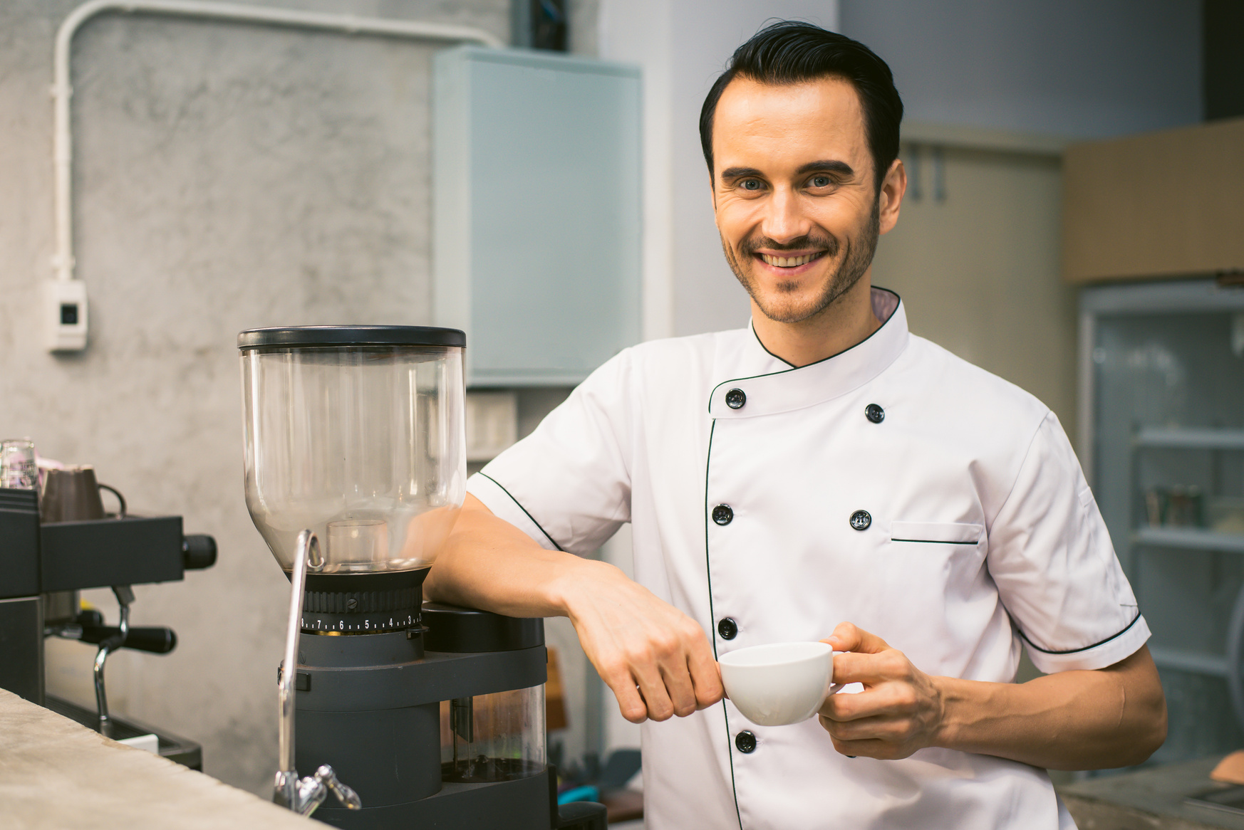
Hi there! I'm Manisha Singh, but you can call me Missha.
I bring together logic and creativity, fueled by a passion for problem-solving and a commitment to being a continuous learner.

Slide 3

INTRODUCTION
Danny opened Danny’s Diner in 2021, featuring sushi, curry, and ramen.
Despite initial enthusiasm, Danny's Diner faces challenges in utilizing operational data effectively.
The restaurant has gathered basic data but lacks the expertise to leverage it for business improvement.

Slide 4
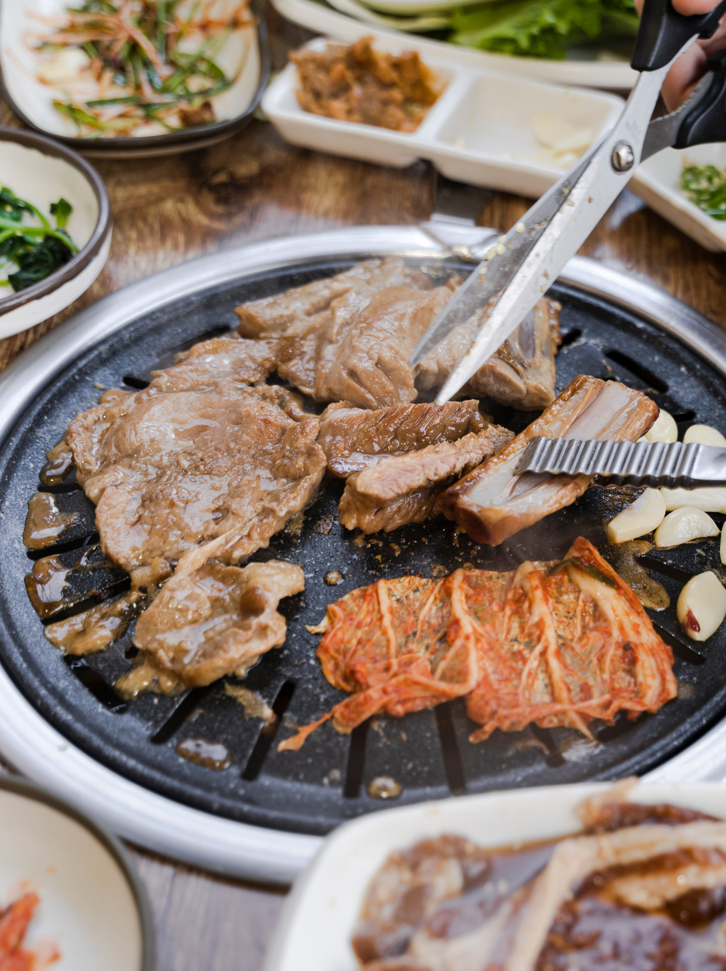
Problem Statement
Danny seeks insights into customer visiting patterns, spending habits, and favorite menu items to enhance personalization and improve customer experience.
These insights will guide decisions on expanding the existing loyalty program, aiming to strengthen customer loyalty.
Three key datasets provided for analysis: Sales, Menu, and Members.

Slide 5
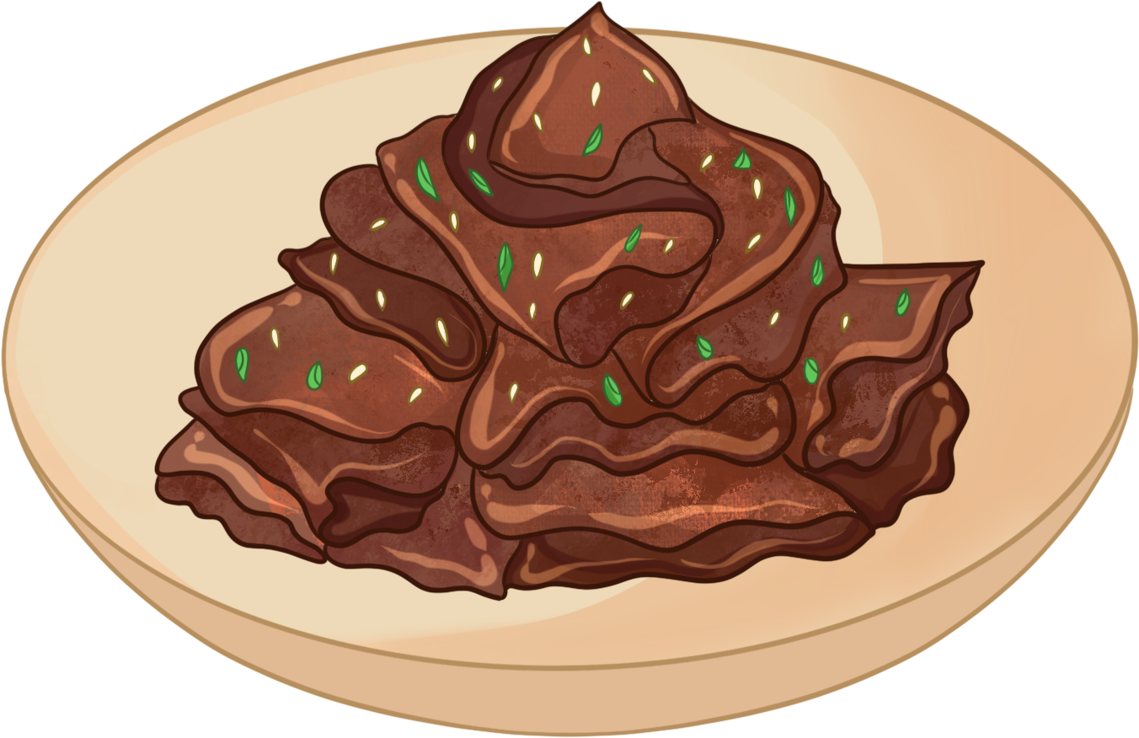

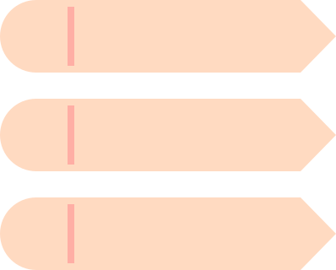
ENTITY RELATIONSHIP DIAGRAM
Members
Sales
Menu
customer_id
customer_id
product_id
join_date
order_date
product_name
product_id
price

Slide 6
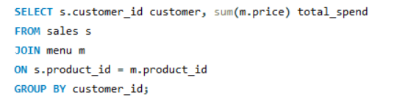
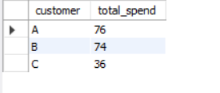
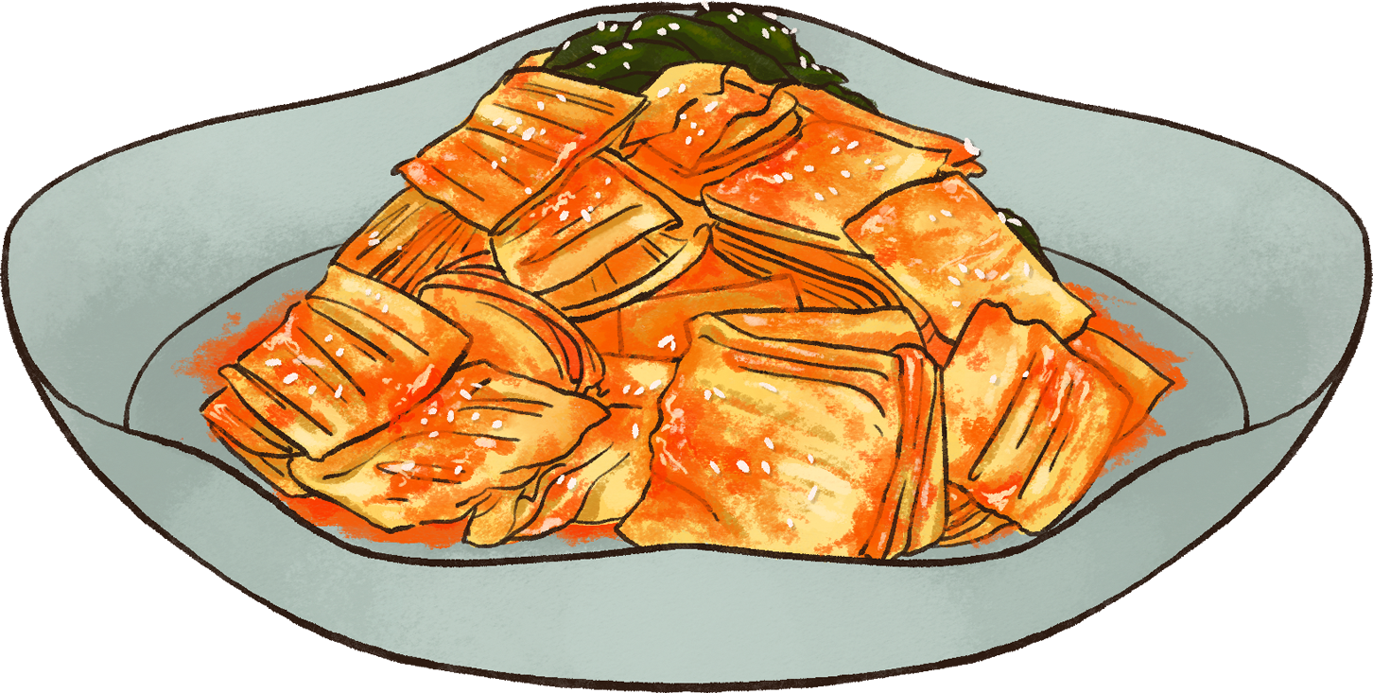
#WHAT IS THE TOTAL AMOUNT EACH CUSTOMER SPENT AT THE RESTAURANT?

Slide 7
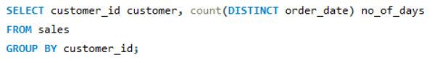
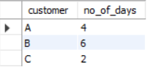
#HOW MANY DAYS HAS EACH CUSTOMER VISITED THE RESTAURANT?

Slide 8
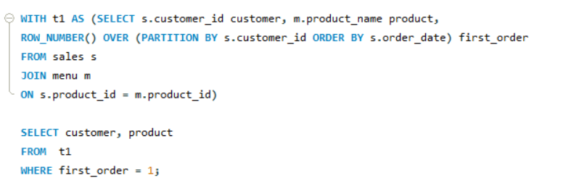
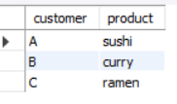
#WHAT WAS THE FIRST ITEM FROM THE MENU PURCHASED BY EACH CUSTOMER?

Slide 9
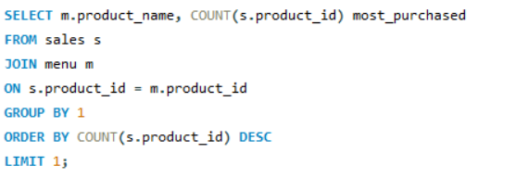
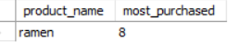
#WHAT IS THE MOST PURCHASED ITEM ON THE MENU AND HOW MANY TIMES WAS IT PURCHASED BY ALL CUSTOMERS?

Slide 10
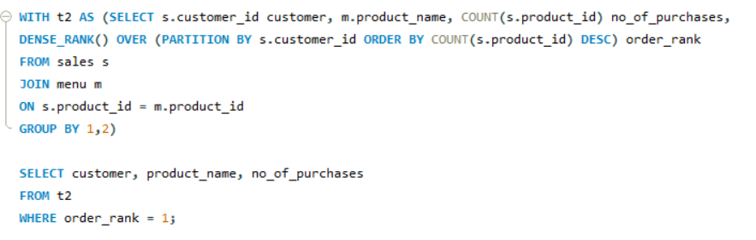
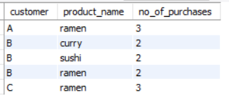
#WHICH ITEM WAS THE MOST POPULAR FOR EACH CUSTOMER?

Slide 11
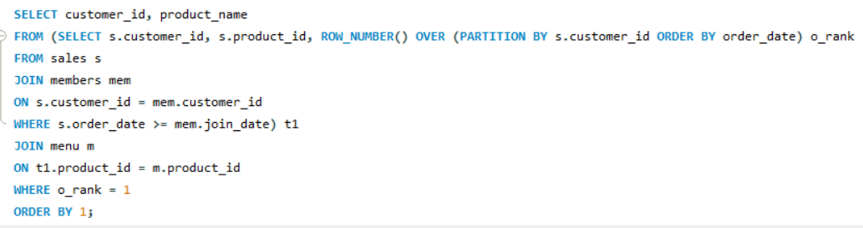
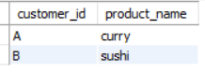
#WHICH ITEM WAS PURCHASED FIRST BY THE CUSTOMER AFTER THEY BECAME A MEMBER?

Slide 12
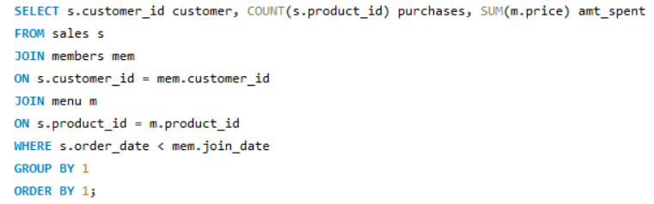
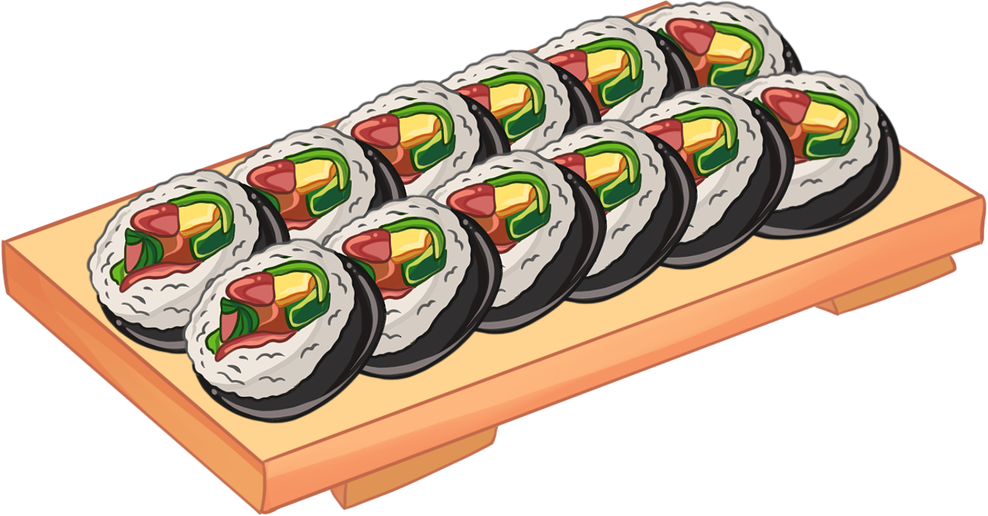
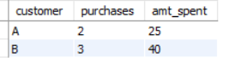
#WHICH ITEM WAS PURCHASED FIRST BY THE CUSTOMER AFTER THEY BECAME A MEMBER?

Slide 13
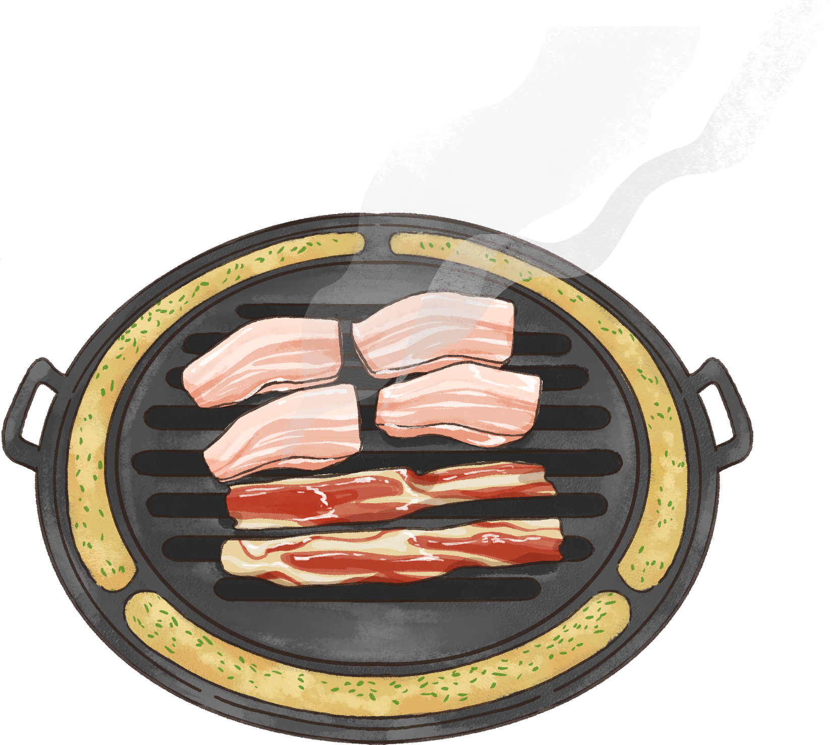
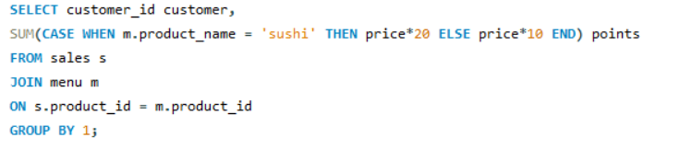
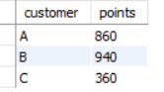
#IF EACH $1 SPENT EQUATES TO 10 POINTS AND SUSHI HAS A 2X POINTS MULTIPLIER - HOW MANY POINTS WOULD EACH CUSTOMER HAVE?

Slide 14

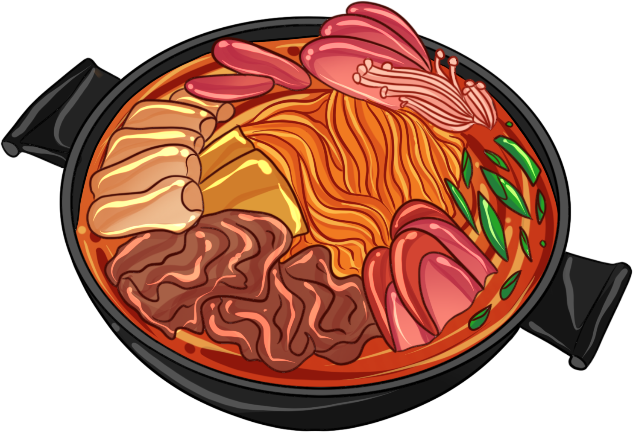
INSIGHTS
The highest spender is Customer A, who spent $76.
Customer B is the most frequent visitor with 6 visits in Jan 2021.
The most popular item at Danny’s Diner is ramen, followed by curry and sushi.

Slide 15
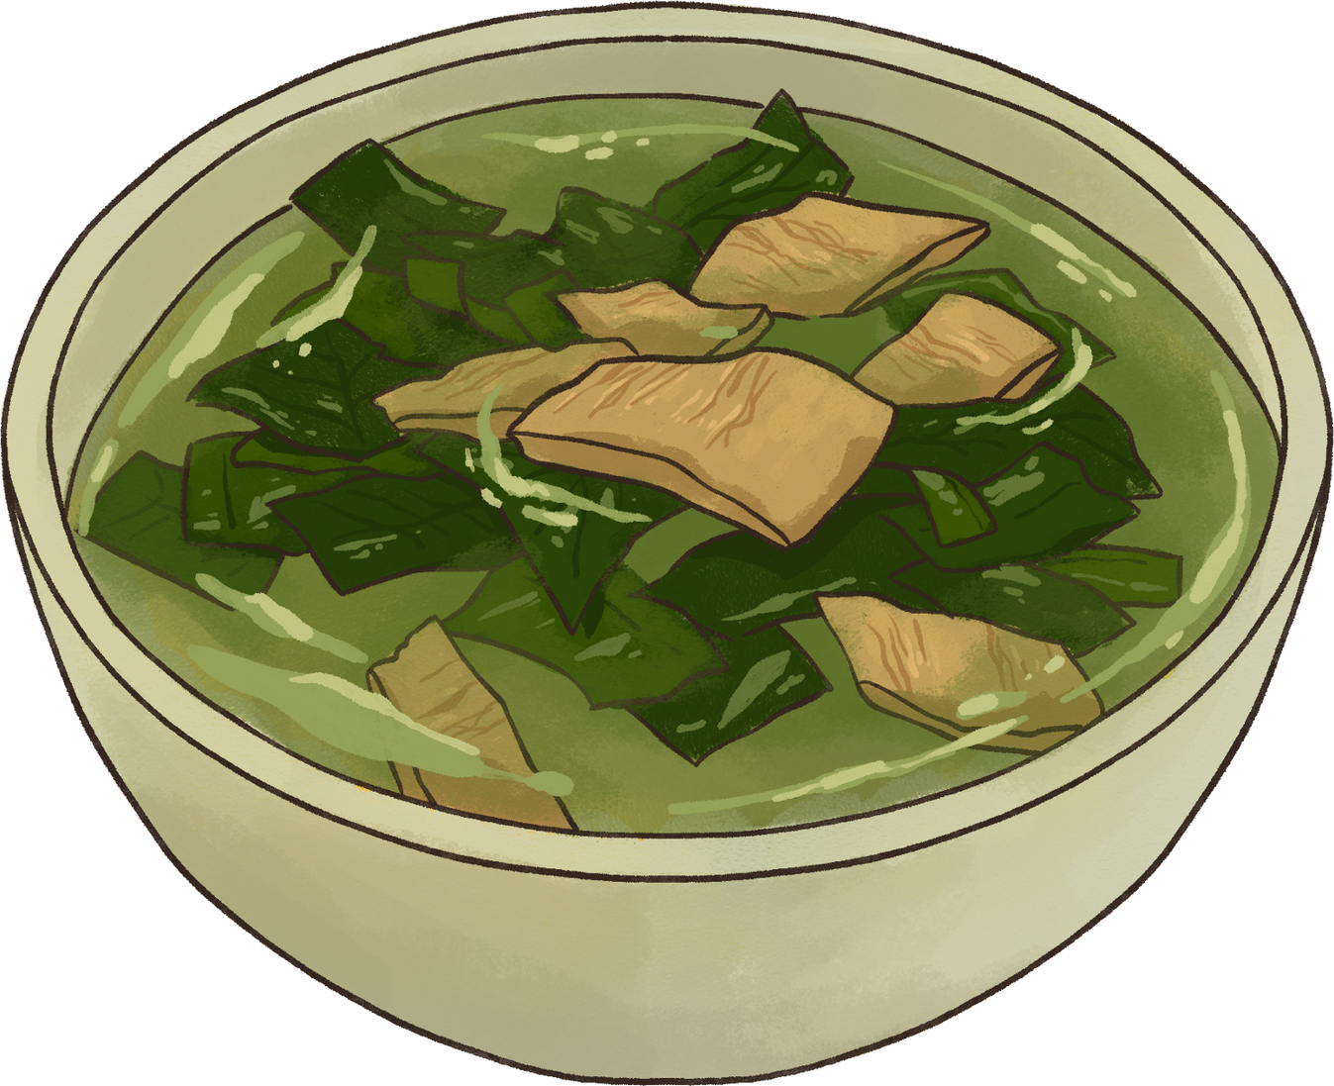


THANK YOU!

